Slide 1
Heating and Cooling
Identifying heating and cooling systems and what are the pros and cons of each.

Slide 2

Old Heating Systems
Fireplace

Slide 3
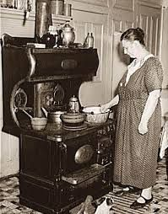
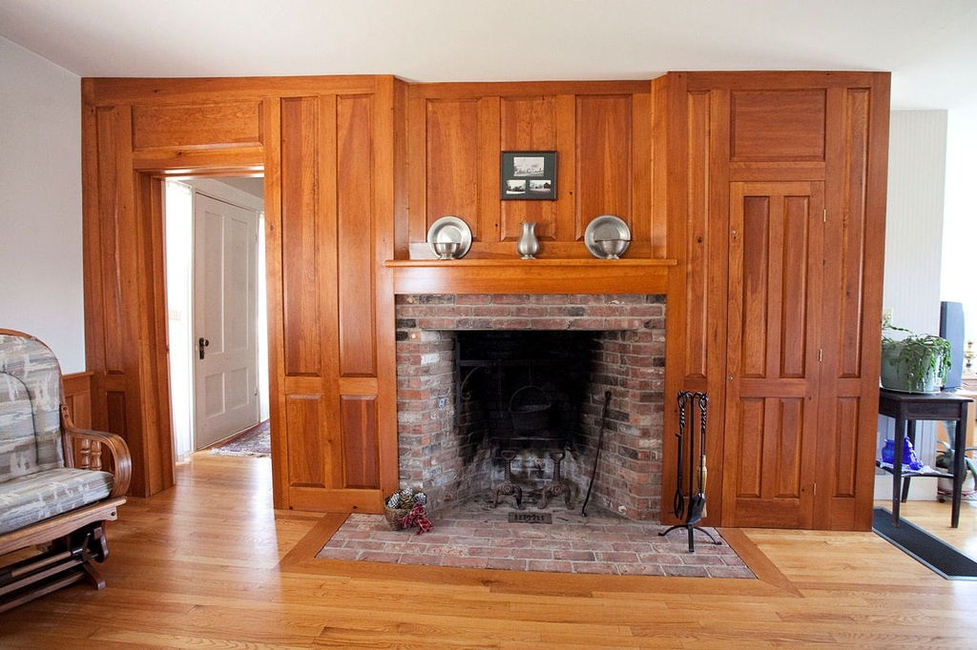
Old Heating Systems
Fireplaces Wood Stove

Slide 4
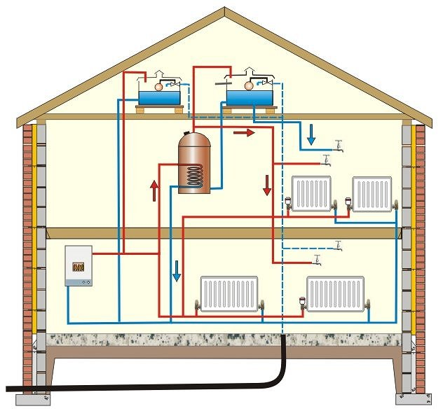
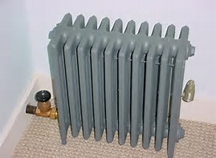
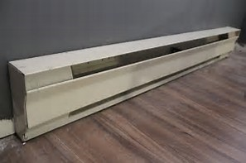
Hot Water or Steam Radiant Heat
Common from 1880s to 1930s

Slide 5
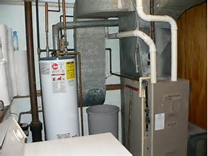
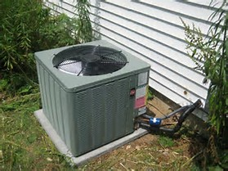
Forced Air Heat and Central Air Conditioning
1930s - Today 1970s - Today

Slide 6
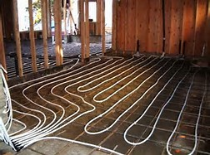
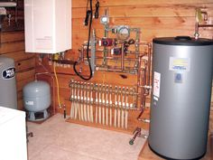
In floor Radiant heat

Slide 7
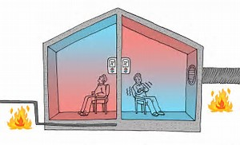
In floor vs Forced Air Heat Distribution

Slide 8
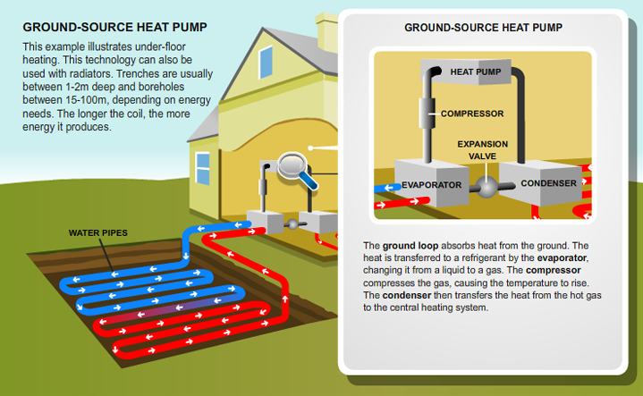
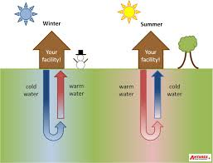
Ground Source Heat Pumps

Slide 9
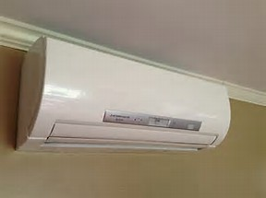
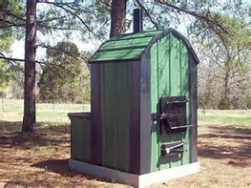
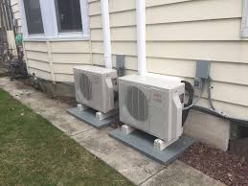
Alternative Systems
Wood Pellet or Corn Burner
Mini-Splits

Slide 10
Windows
What styles of windows are there and how do the very in quality?

Slide 11
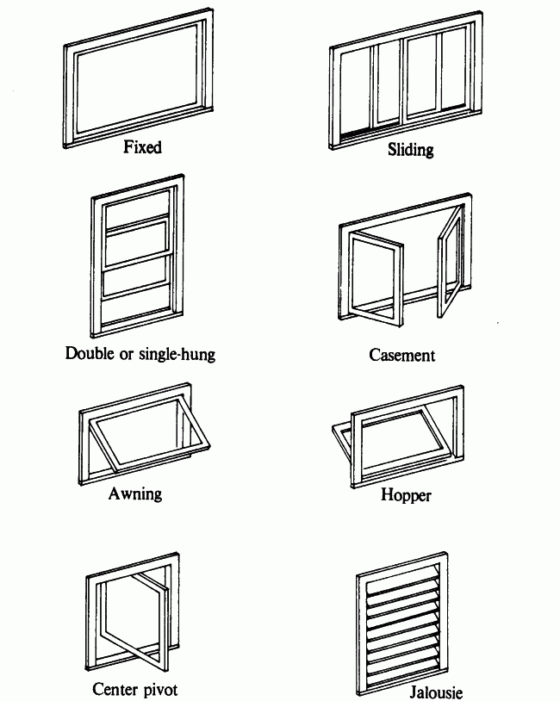
Window Styles

Slide 12
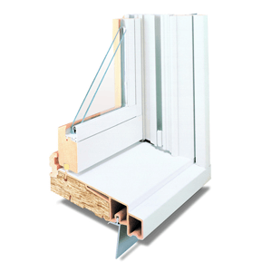
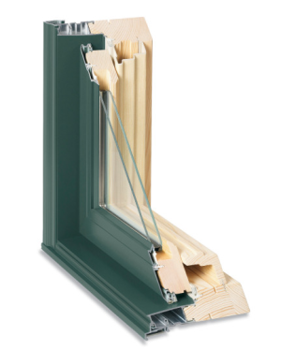
Window Materials
Vinyl Clad Metal Clad

Slide 13
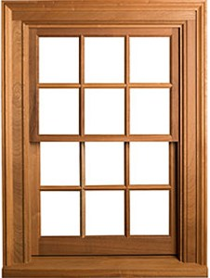
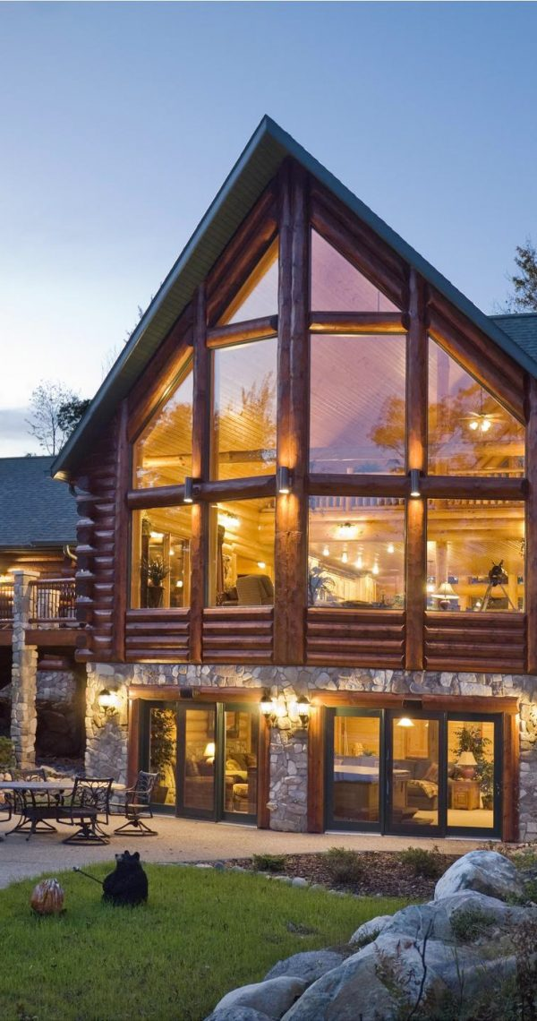
Window Materials Continued
Wood Geometric Design

Slide 14
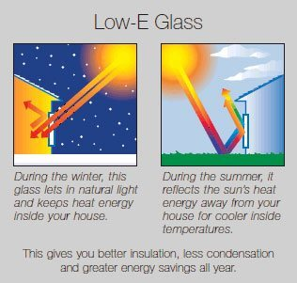
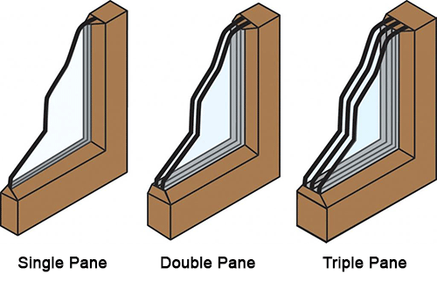
Window Quality

Slide 15
Siding
With countless options for siding how can you tell the difference?

Slide 16
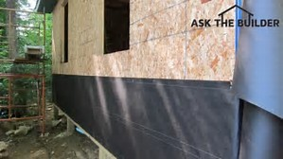
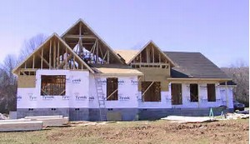
House Wrap under the siding
Tar paper Tyvek

Slide 17
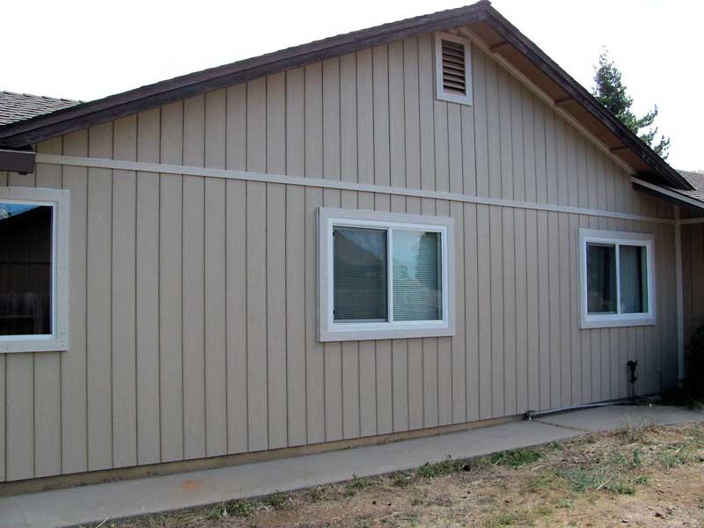
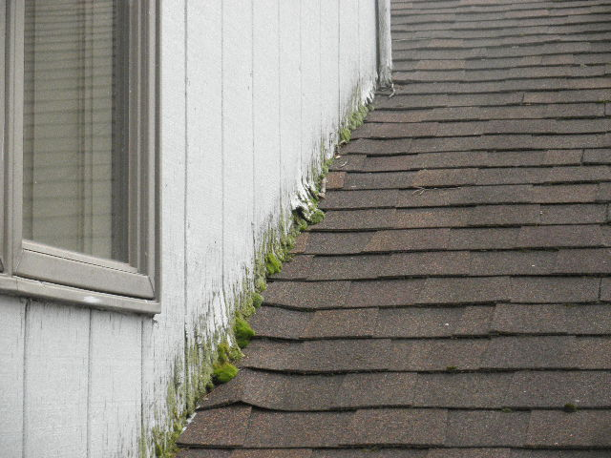
Wood and Wood Products Continued
T1-11 Panel Plywood

Slide 18
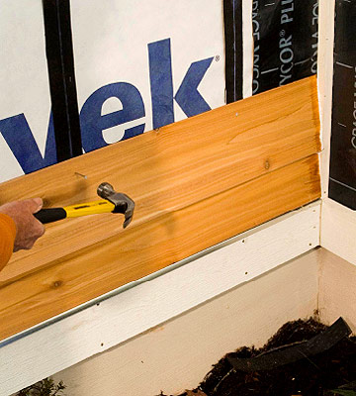
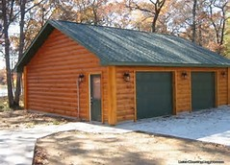
Wood and Wood Products
Wood lap Log siding

Slide 19
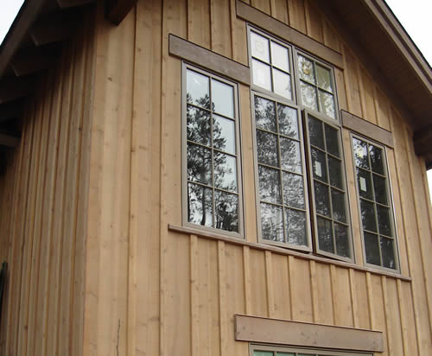
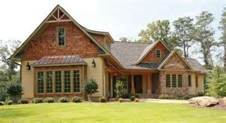
Wood and Wood Products Continued
batt & Board Shakes

Slide 20
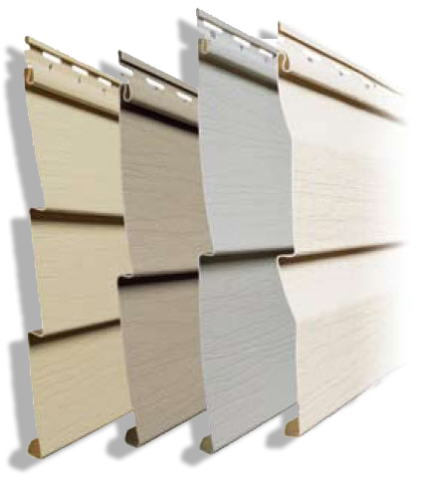
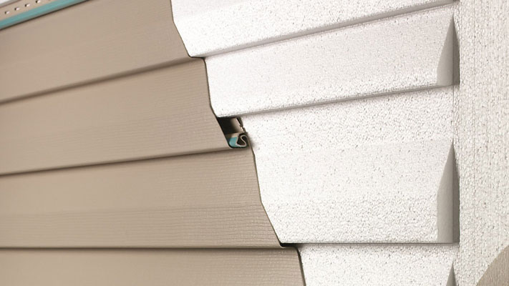
Vinyl Siding
Basic Insulated

Slide 21
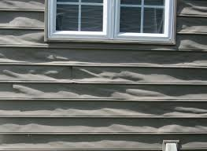
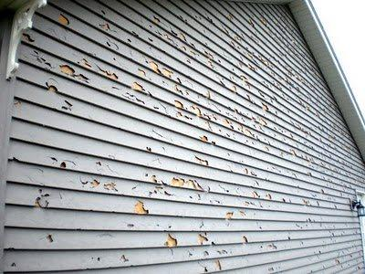
Vinyl Siding Issues
Melting Wholes or Cracks

Slide 22
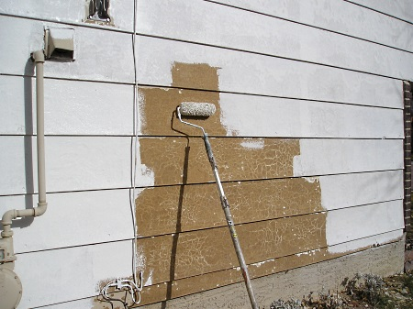
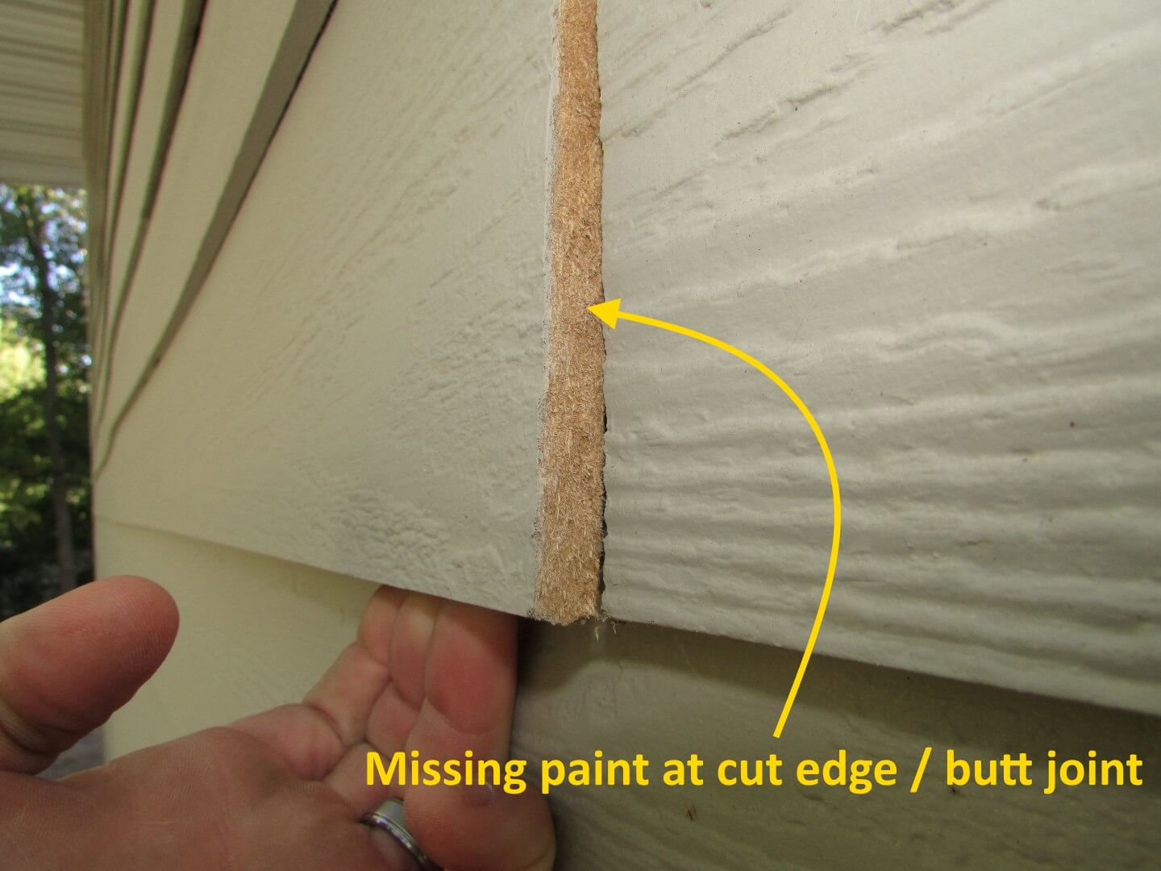
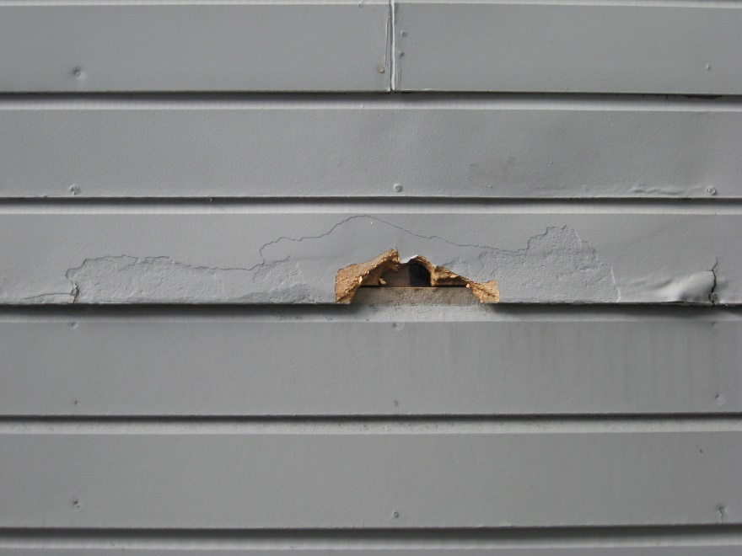
Composite Engineered
Masonite LP Smartside

Slide 23
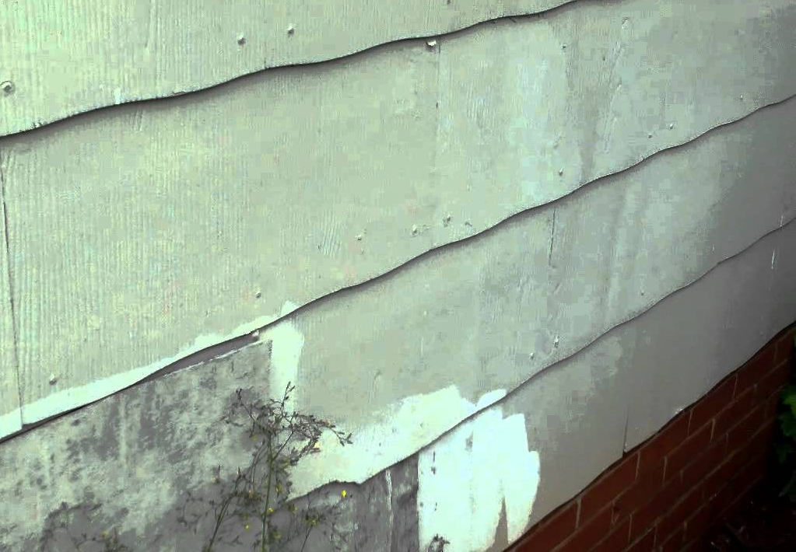
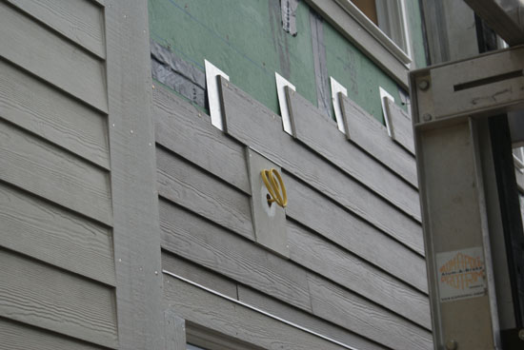
Concrete Products
Asbestos 1920s - 1950s Cement board/1990s -Present

Slide 24
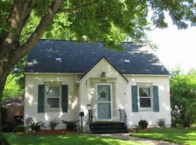
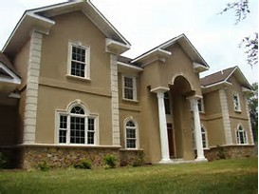
Stucco
Traditional EIFS (Synthetic)

Slide 25
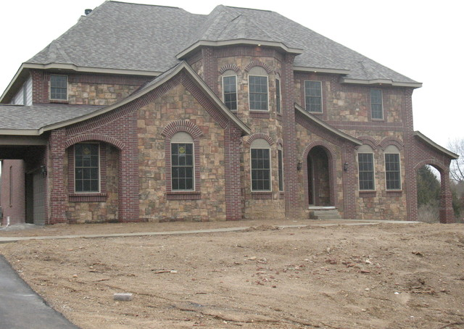
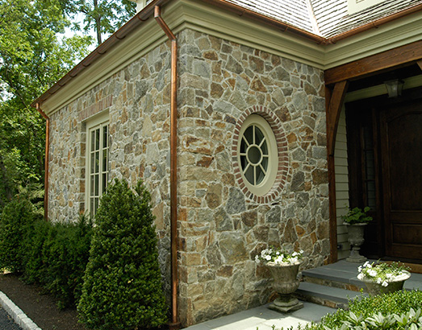
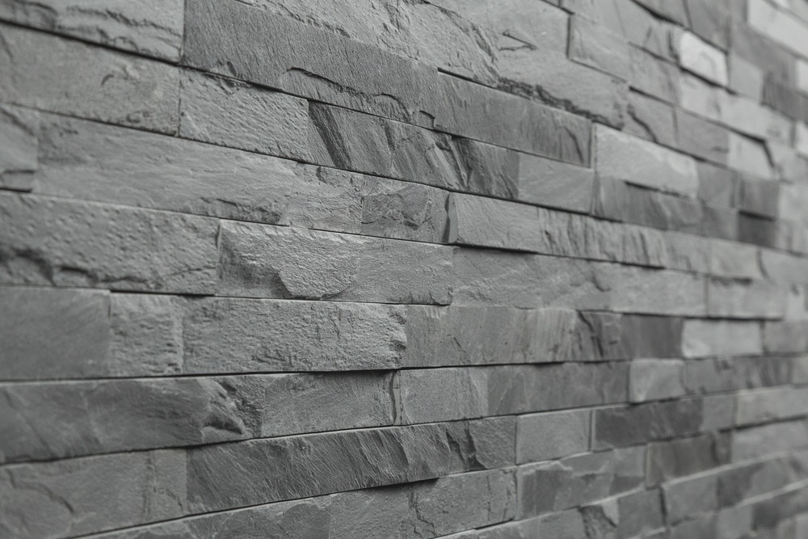
Stone
Cultured Stone/Brick Field Stone
Slate

Slide 26
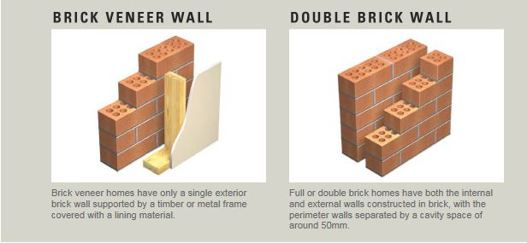
Brick Veneer vs Brick Construction

Slide 27
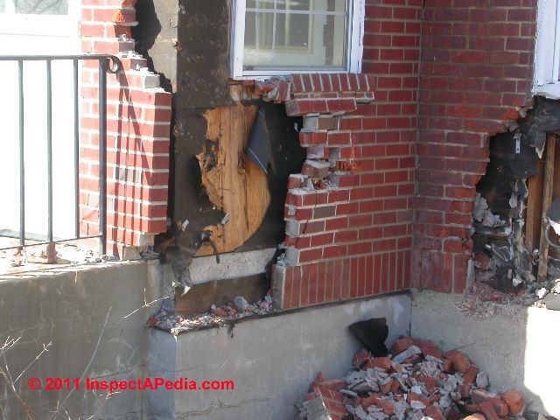
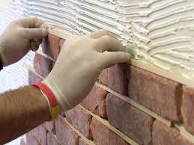
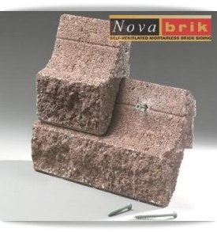
Brick Veneer Options

Slide 28
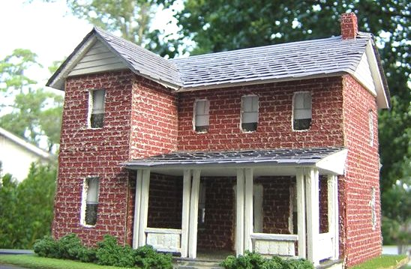
Full Brick Construction

Slide 29
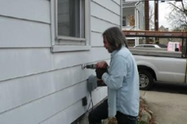

Metal Siding
Aluminum Steel lap

Slide 30


Metal Siding
Vertical Steel Steel panel

Slide 31
Doors
What are hollow core, 6 panel, custom doors and why does it matter?

Slide 32



Door Construction
Hollow Core 6 panel Custom

Slide 33


Hollow core Doors

Slide 34

Solid Core Doors

Slide 35



Steel Doors

Slide 36



Fiberglass Doors

Slide 37


Custom

Slide 38





Hardware - Low, medium, High End

Slide 39
INTERIOR WALLS AND CEILINGS
Trust me it is more interesting than watching paint dry on a wall…

Slide 40


Typical Wall Finish
Taped & Mudded Drywall 1950s+ Lath and Plaster Pre 1950s

Slide 41


Tongue and Groove (T&G)
Old T&G Ceiling New T&G Carsiding

Slide 42


Paneling
Inexpensive Expensive

Slide 43


Wainscot and sheetrock
Inexpensive Expensive

Slide 44


Alternative Wall materials
Tile Barn Wood

Slide 45


Ceilings
Cardboard Squares over Plaster Suspended Ceiling

Slide 46


Textured over sheetrock/plaster
Popcorn Knockdown

Slide 47
Interior Flooring
Price, style, durability, with countless options and lots of pros and cons…

Slide 48


Carpet
Which is better quality and whY?

Slide 49



Manufactured Tile
Ceramic Porcelain

Slide 50




Natural Stone Tile
Slate, Travertine, marble, Others

Slide 51


Laminate and engineered Flooring
Laminate Engineered Wood

Slide 52


Wood Flooring
Engineered Wood Solid Wood

Slide 53


Wood Flooring Continued
Hardwood Softwood

Slide 54


Linoleum / Vinyl
Basic Upgrade

Slide 55


Linoleum…It’s been around a while
From Erik’s House, Burlap backing says 1914 on label

Slide 56


Concrete
Colored Colored and Stamped

Slide 57
Trims
Quality vs Cheap, what a difference…

Slide 58

Trim Types and Locations

Slide 59



Hardwood Trims Good Quality
Oak Cherry Hickory

Slide 60



Soft and Hardwoods Medium quality
Pine Fir Poplar

Slide 61



Laminated, Vinyl, Composite
Laminate Vinyl Rolled PVC

Slide 62


Other Cost Factors Continued
Crown Molding
More Pieces, More Cost

Slide 63

Other Cost Factors
Narrow vs Wide - More material more cost

Slide 64
Counters and Cabinets
Factory or Custom?

Slide 65


Countertops Least expensive
Many designs, Formica Edged or wood edged

Slide 66


Countertops Stone
Natural Stone (Granite, quartz, etc.)
Engineered Stone (Cambria)

Slide 67


Countertops Stone Alternatives
Tile
Concrete

Slide 68



Countertops Alternatives
Butcher Block
Corian
Stainless Steel

Slide 69


Custom Cabinets, What to Look for
Solid Wood, Good Joining, Amount of Cabinets

Slide 70


Inexpensive cabinets
Pressed Board with a veneers or plywood

Slide 71


Inexpensive cabinets Continued
Pressed Board Less Cost = Less Durability

Slide 72



Floor Plans
Open Floor Plan
Peninsula with Upper Cabinets
Galley Kitchen

Slide 73




Hardware – Hinges and slides
More Cost Less Cost

Slide 74





Hardware - Pulls and Handles
Lesser metal, Thin Coating or paint
Better Solid materials, no coating

Slide 75
bathrooms
Size of the space and materials used are important and make a difference in this highly used space.

Slide 76



Quality of Materials
Low Medium High

Slide 77



Tub styles
Soaker Tubs, Claw foot and Jetted

Slide 78




Tub Materials
Cast Iron Fiberglass

Slide 79



Showers Fiberglass
Prefabricated Fiberglass

Slide 80


Showers Tile
Tile Shower Pan 1960s Vintage Tile

Slide 81




Showers Tile
Ceramic Tile Natural Stone

Slide 82




Shower Fixtures
Inexpensive vs Higher Cost – See and feel the difference

Slide 83
Decks
Size, shape, and materials matter

Slide 84



Decks Low Grade – Basic Materials/Design
Treated Wood Face Screwed
Simple or No Railings

Slide 85



Decks Mid-Grade – Larger, more complex
Cedar Composite (Azek, Trex, etc…)
More Complex Railings

Slide 86



Decks High Grade – The Sky is the Limit
Exotic Woods Custom design
Hidden fastener (mid & High Grade)

Slide 87




Railings – Countless materials and styles
Metal Cable and Picket Glass, Composite

Slide 88
Garages
Pole vs stick built, finished vs unfinished, gravel, plain concrete or epoxy floor, parking cars or man cave?

Slide 89


Interior Finish
Unfinished Fully Finished

Slide 90



Garage Lining
Steel Drywall with Insulation
OSB with Insulation

Slide 91



Garage Heating – Most Common
Space Heat Radiant in-Floor
Ceiling Radiant

Slide 92




Garage Floors – Dirt, Concrete, Epoxy and others

Slide 93


Pole Frame Garages

Slide 94


Stick Built Garages

Slide 95
Depreciation
What is due to wear and tear and what are system failures?

Slide 96


Depreciation
0% Depreciation 100% Depreciation

Slide 97


Structural Failures Foundation/Slab
Step Cracking large cracks and Heaving

Slide 98


Structural Failures Floors/Wall
Structural crack Floor Joist Dry rot

Slide 99


Structural Failures Floors/Wall
Header Failure Physical or External Obsolescence?

Slide 100


Excess Physical Depreciation Interior
Typical Wear and Tear Excess Wear

Slide 101



Excess Physical Depreciation Interior
Roof leaking Excess Carpet Wear
Chipped Asbestos tile

Slide 102



Excess Physical Depreciation Shingles

Slide 103


Excess Physical Depreciation Roof
Roof Sagging Waving Plywood

Slide 104


Excess Physical Depreciation Siding
Wood, Vinyl, Asphalt all Bad Worn Masonite

Slide 105


Physical Depreciation Siding
Typical Peeling, no rot Excess wear – Dry rot

Slide 106


Physical Depreciation Decks
Typical Peeling, no rot Excess wear – Dry rot

Slide 107
Lifespan of Typical house Components
Overall House 100+
Shingles 15-50
Siding 25-50+
Exterior paint 7-10
Windows 20-50
Doors 30-50
Decks 20-25
Driveways 20-50
Flooring 10-100+
Water Pumps/heaters 10-20
Piping 40-70+
Valves/Fixtures 20-40
Furnace 15-20
Central Air 12-15
Kitchen Cabinets 40-50
Countertops 20-50+
Electric Panels 60+
Electrical Wiring 100+

Slide 108
Contact
Jason Jorgensen – Jason.Jorgensen@co.meeker.mn.us
Erik Skogquist –
skog0111@umn.edu

